Slide 1
INF0 341 Data Storage and Backup
By
Bob Larson

Slide 2
Topics Covered
How did we get from here to here?
View of Web Based Operation
RAID Storage Arrays
Evolution of Storage Area Networks (SAN)
What is Fibre Channel
SANs With Redundancy
The Hard Drive is now the bottleneck
Virtualization and SAN
Distributed Clouds
Failover / Recovery Systems
Backup and Retention
Backup Server Systems

Slide 3
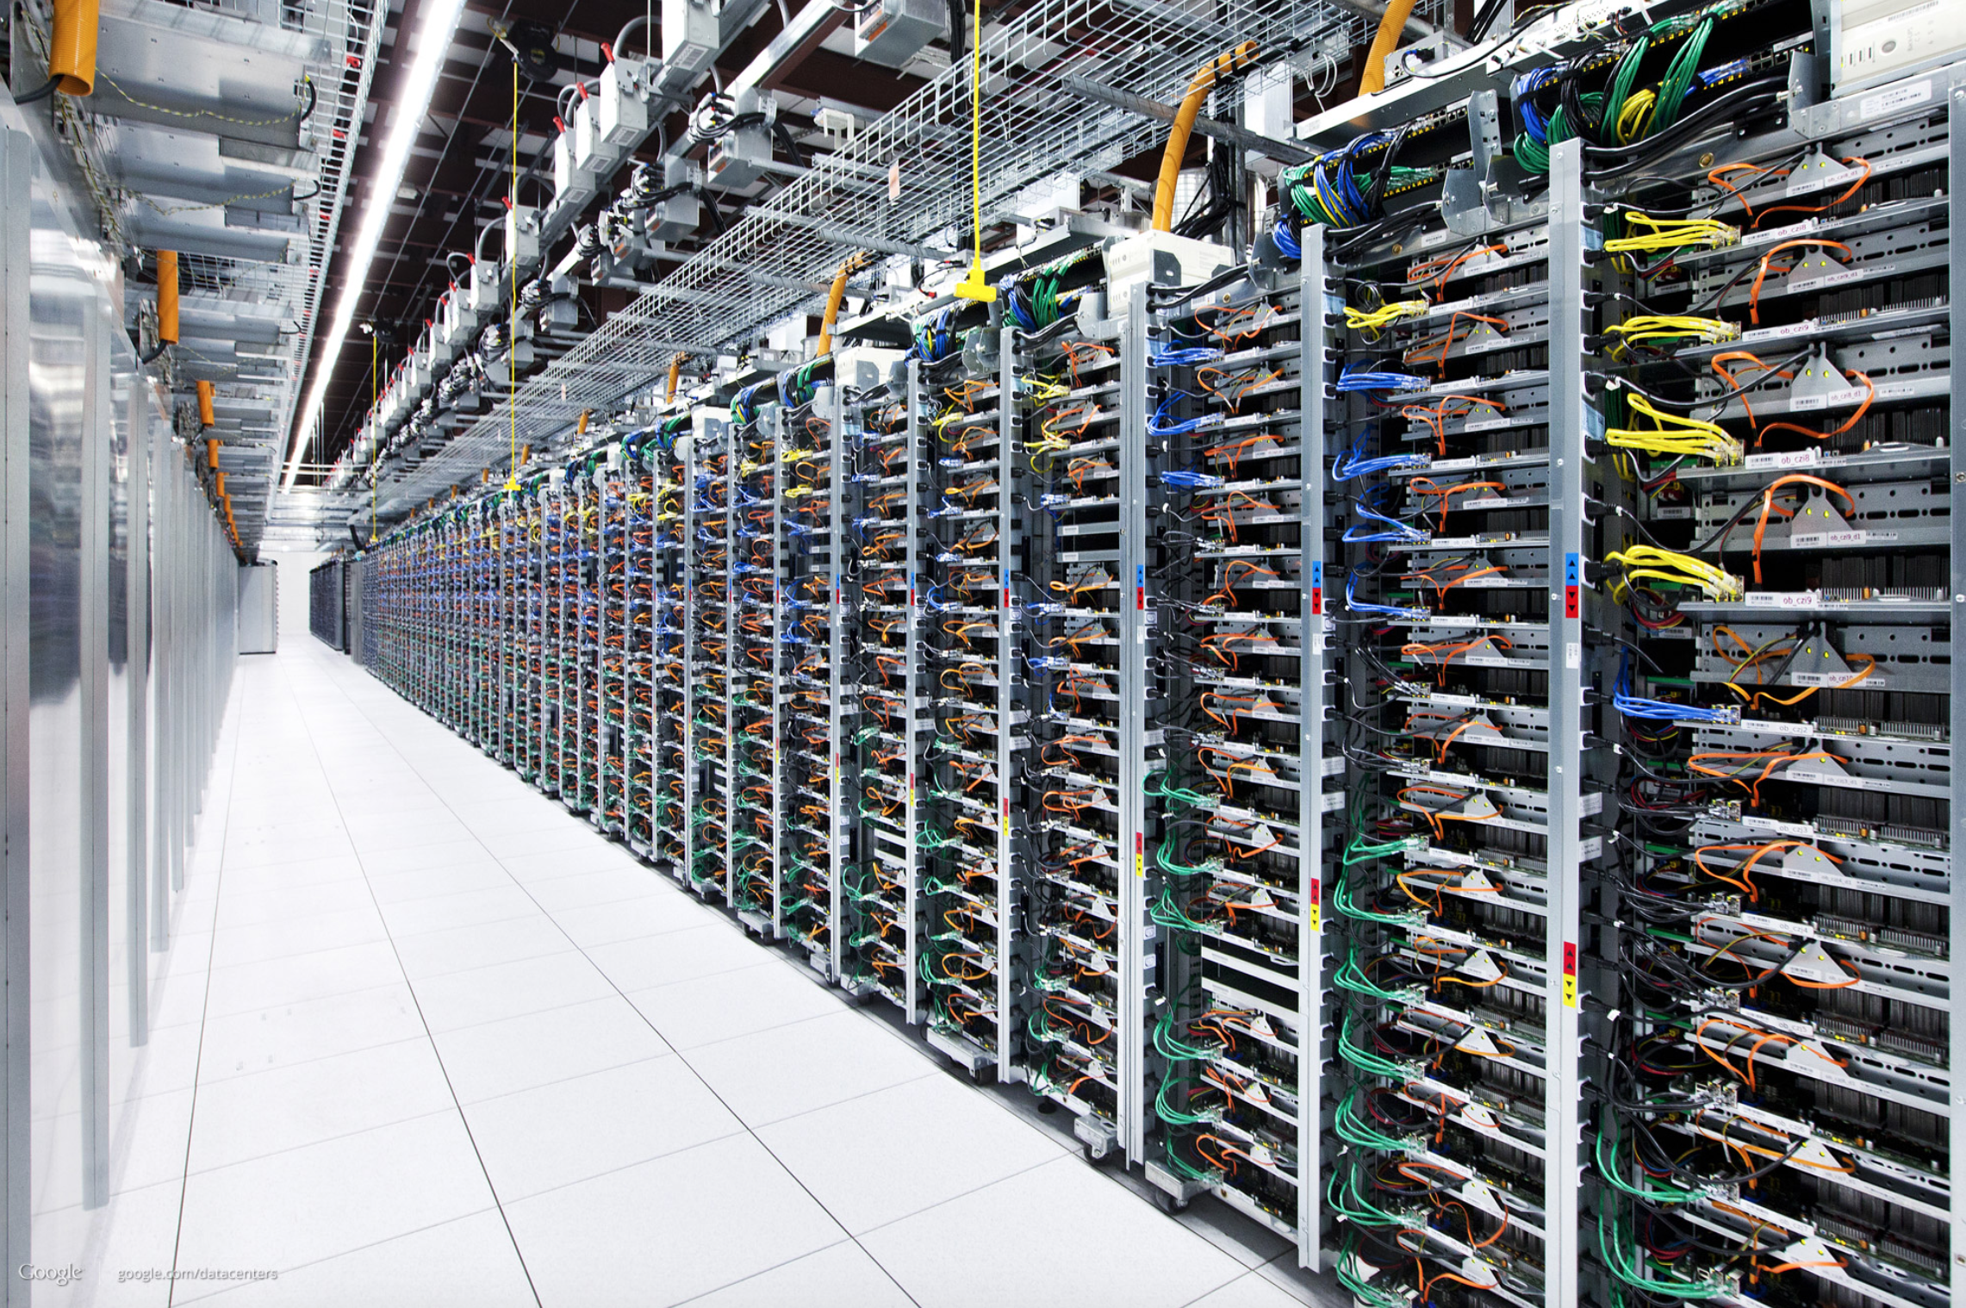
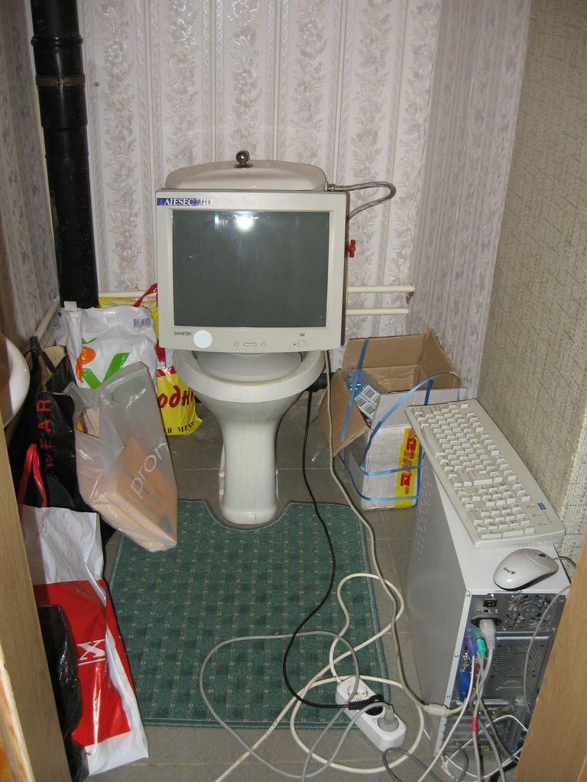
How did we get from here to here?

Slide 4
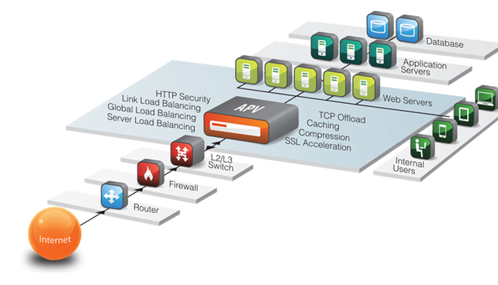
View of Web Based Operation

Slide 5
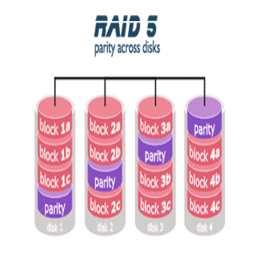
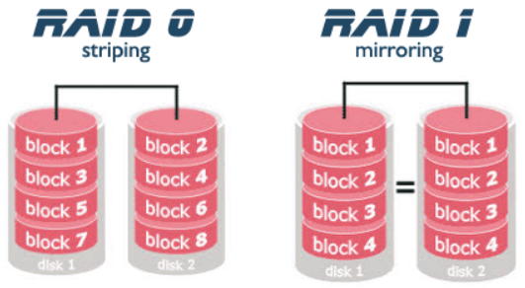
RAID Storage Arrays

Slide 6
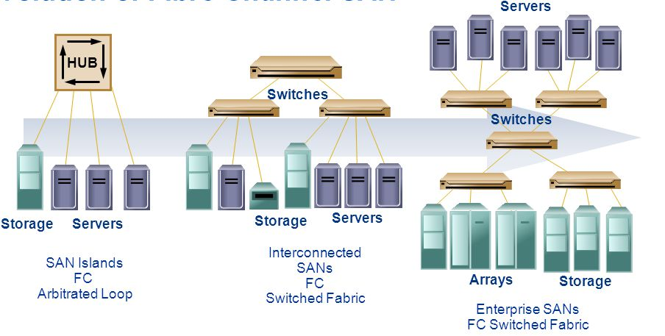
Evolution of Storage Area Networks (SAN)
FC = Fiber Channel

Slide 7
What is Fibre Channel
Technology for transmitting data between devices
At up to 4 to 10 Gbps (40 Gbps in the future)
Suited for
Connecting computer servers to shared storage devices
Interconnecting storage controllers and drives
Up to ten KM (about six miles) apart with optical fiber
Not required for shorter distances
Also works using coaxial cable for very short runs

Slide 8
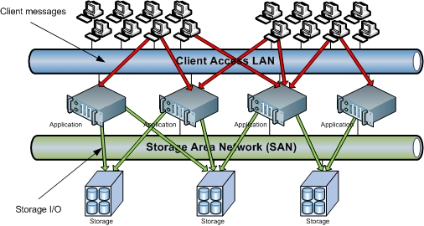
SANs With Redundancy

Slide 9
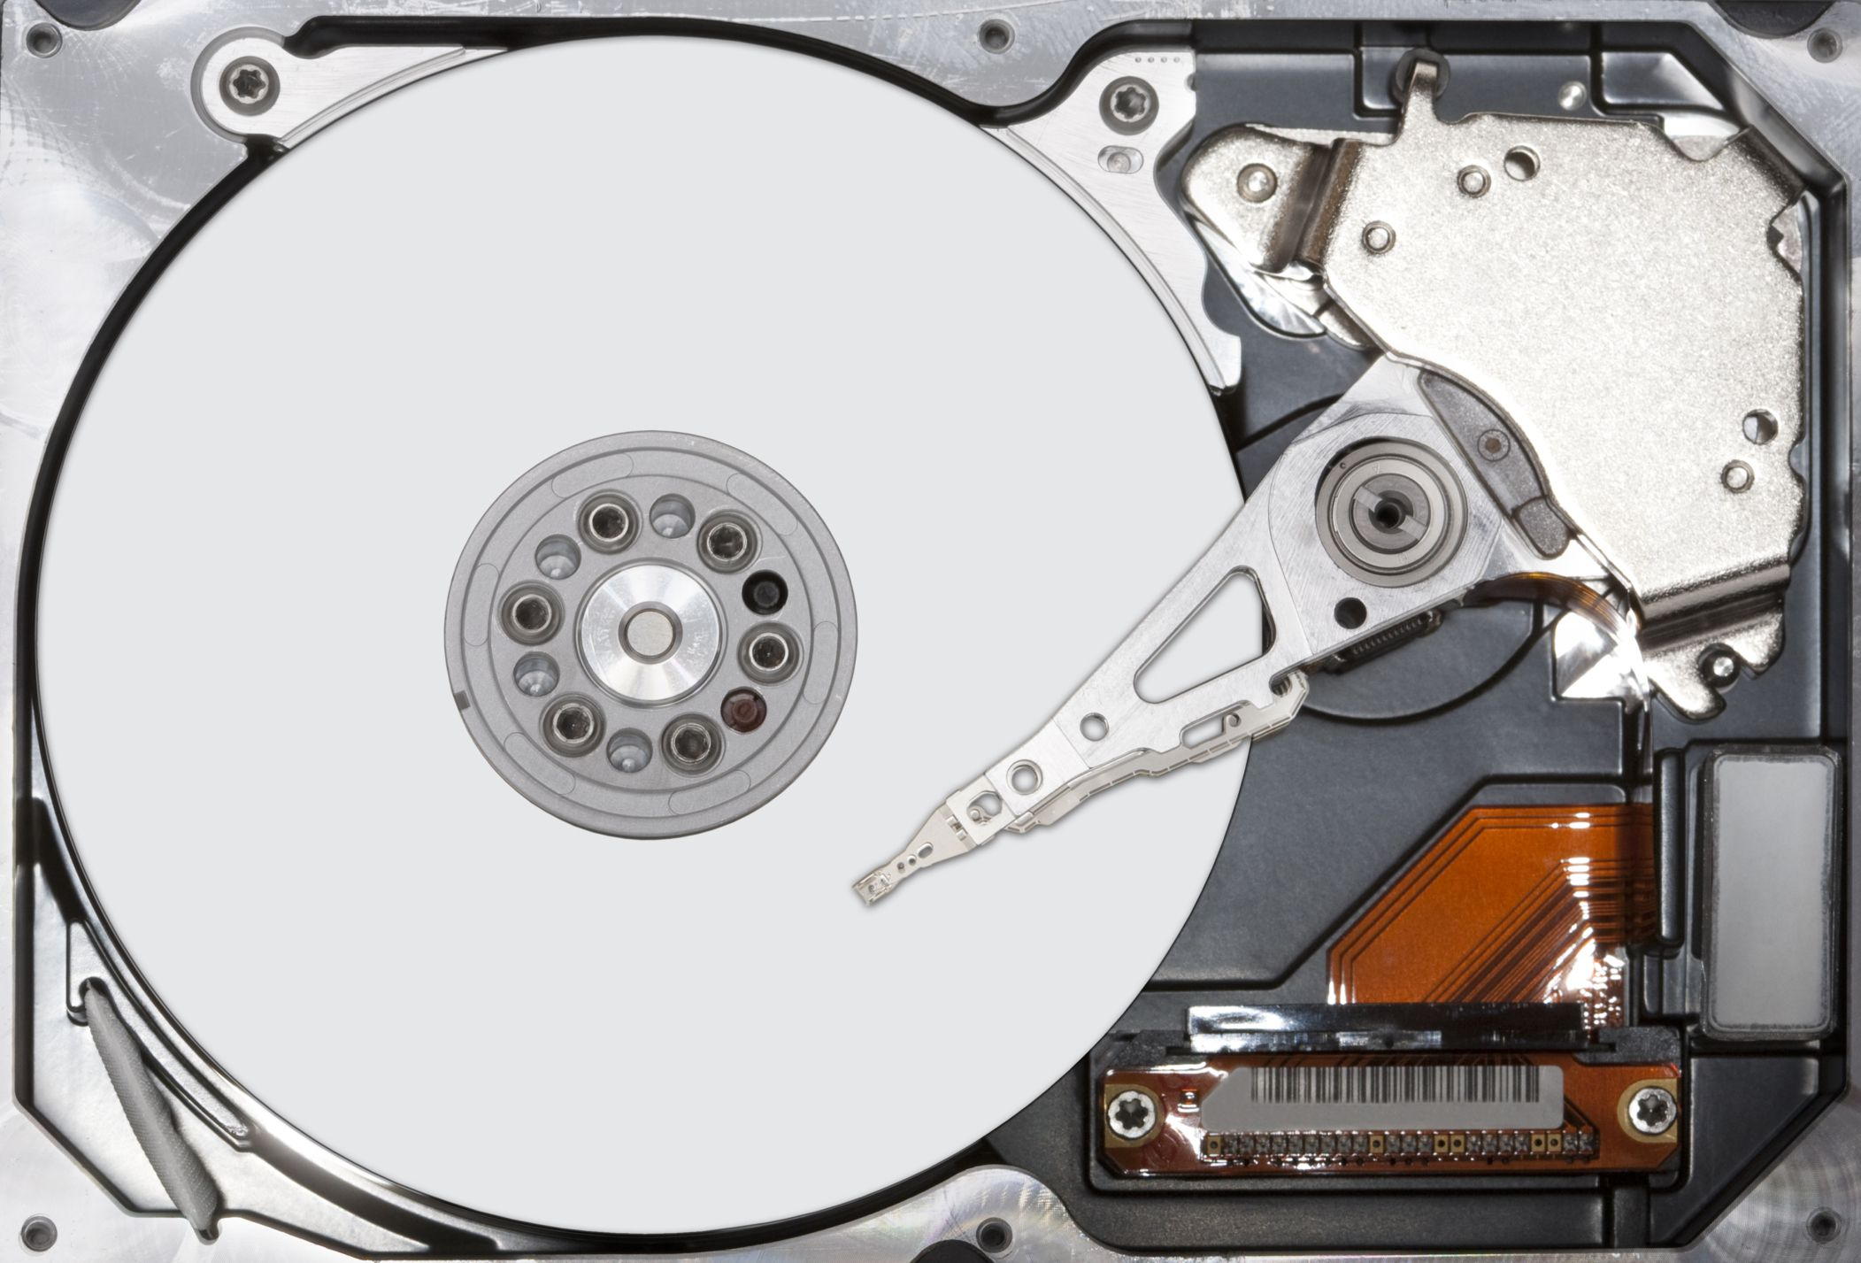
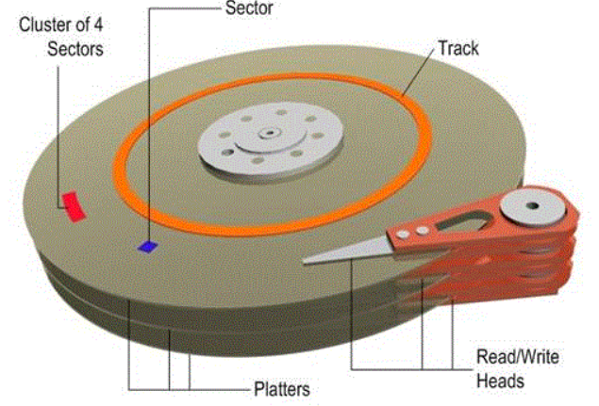
The Hard Drive is now the bottleneck

Slide 10
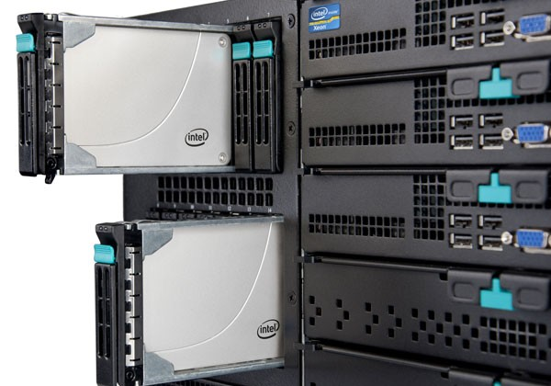
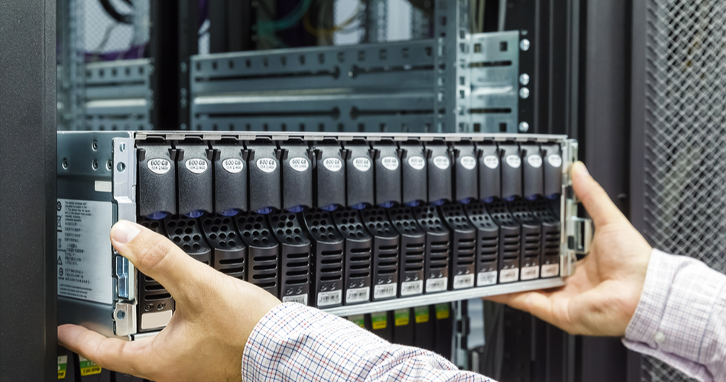
Solid State Drives (SSD)
Faster Retrieval
Lower Energy Cost
The thumb-drive grows up Capacity: 1–8 TB

Slide 11
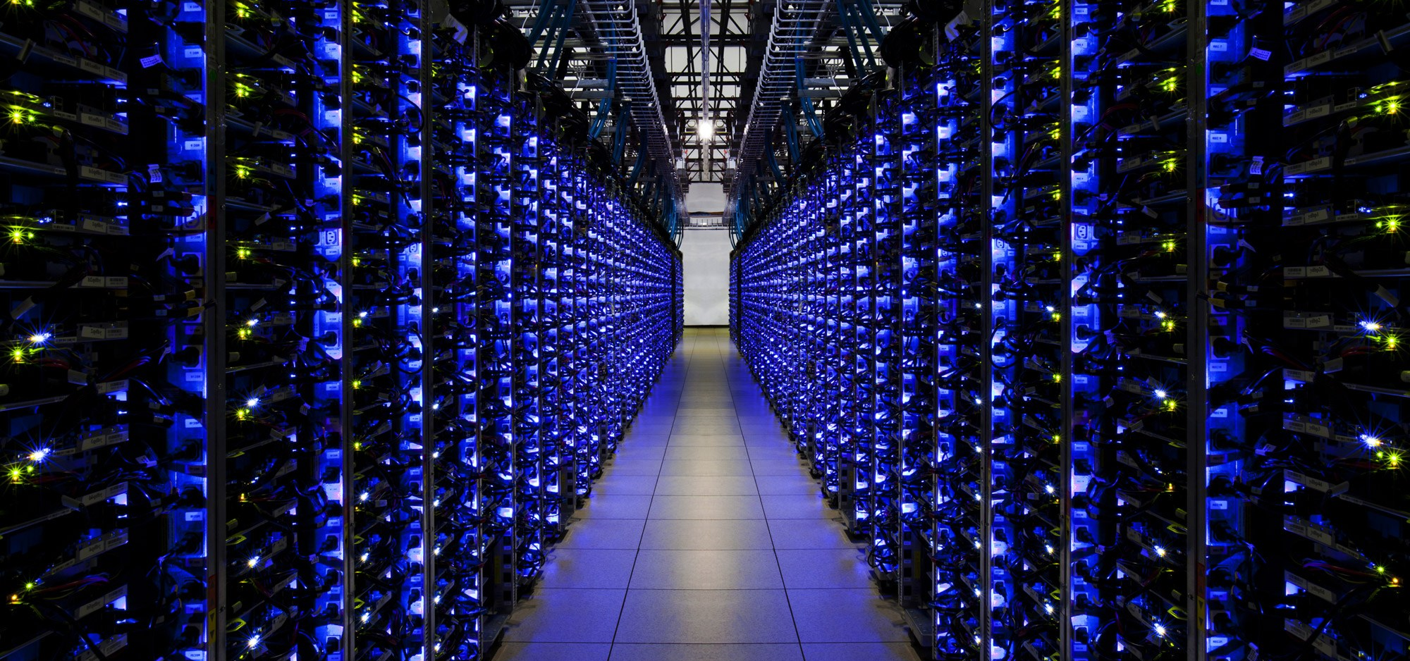
SSD Filling the Room

Slide 12
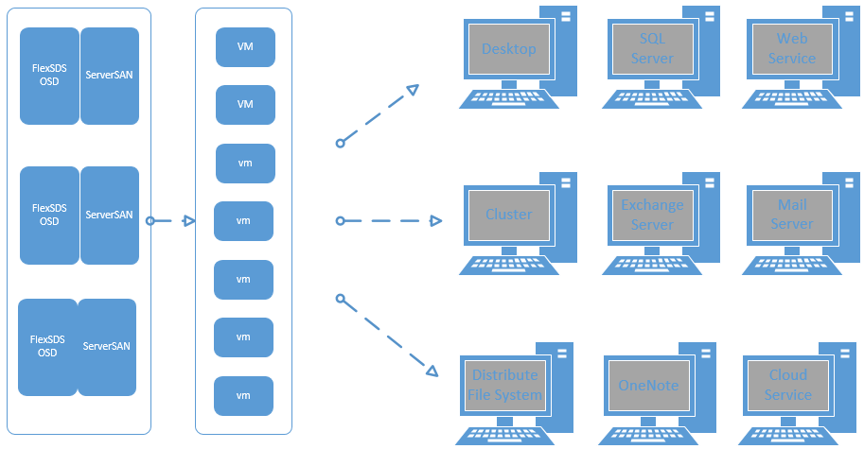
Virtualization and SAN

Slide 13
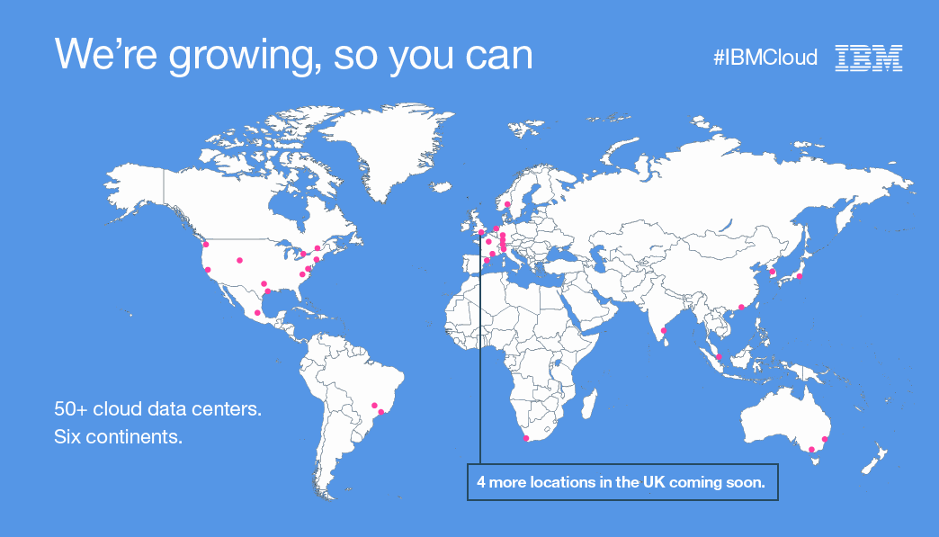
Distributed Clouds

Slide 14
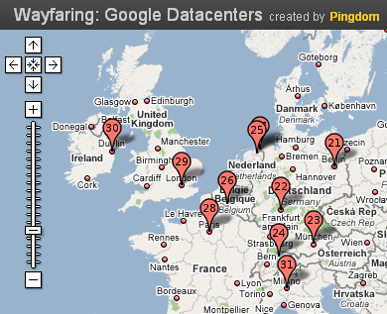
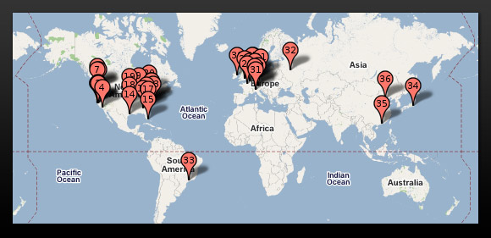
Google’s Data Centers

Slide 15
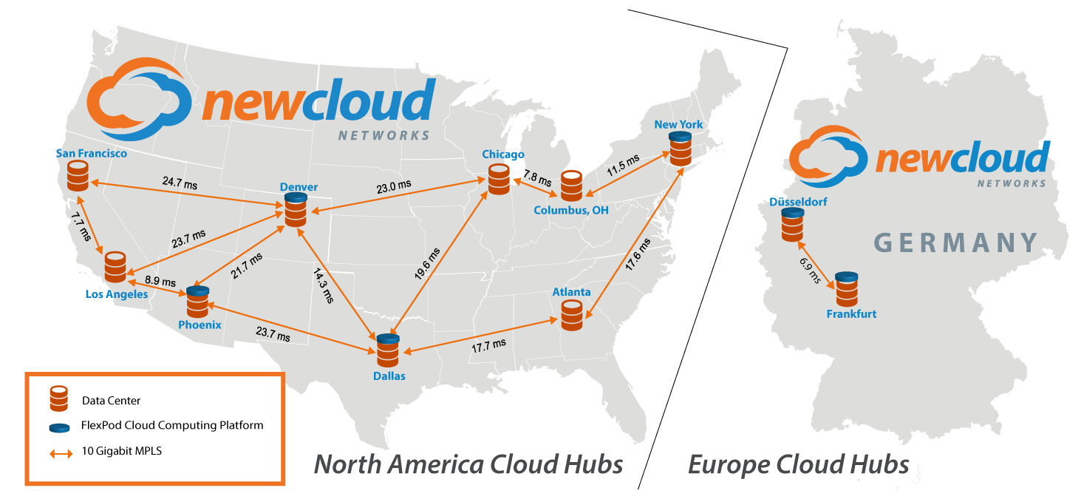
It’s Not Just the Giants We All Know

Slide 16
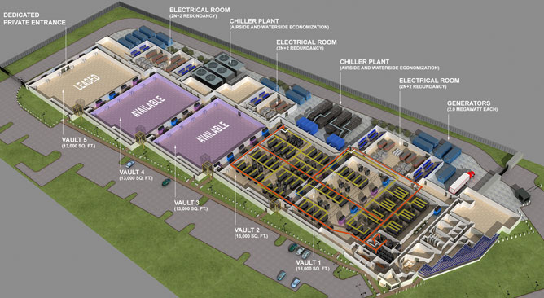
All Built With Excess Capacity

Slide 17
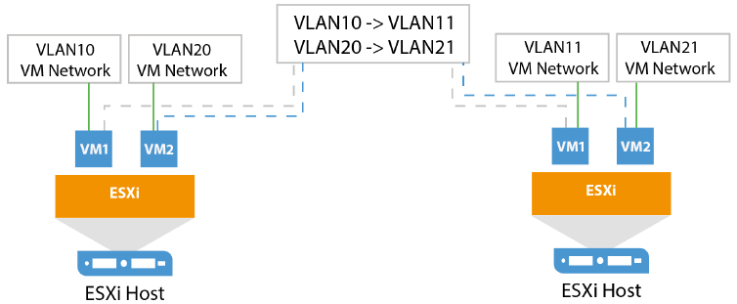
Failover / Recovery Systems

Slide 18
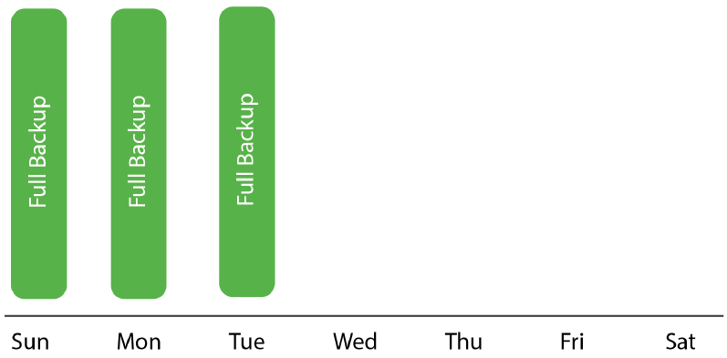
Backup and Retention
Takes up a lot of capacity
With a retention policy set to keep three restore points
We would have three full copies of the backup

Slide 19
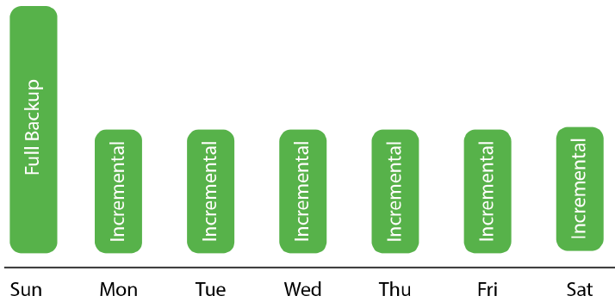
Incremental Backups
Solve the issue of capacity
Simply copy the blocks that have changed
Require less space and are faster to perform
Always need to have a complete full backup availabl

Slide 20
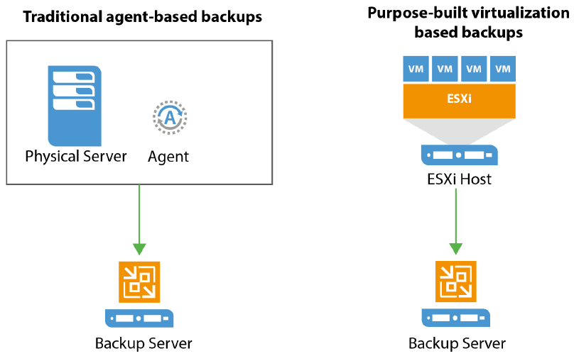
Backup Server Systems

Slide 21
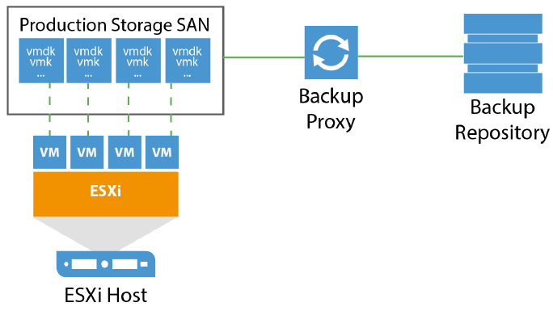
Direct SAN Access
Fastest and most efficient way to retrieve data for a backup
Producing no load on the production networks
Requires your backup server or proxy to have a direct Fibre Channel or iSCSI connection to your SAN
It can mount and unmount your source LUNs, accessing the VM files directly and bypassing both the TCP/IP network and your ESXi (hypervisor) servers
In some cases, it can be virtualized

Slide 22
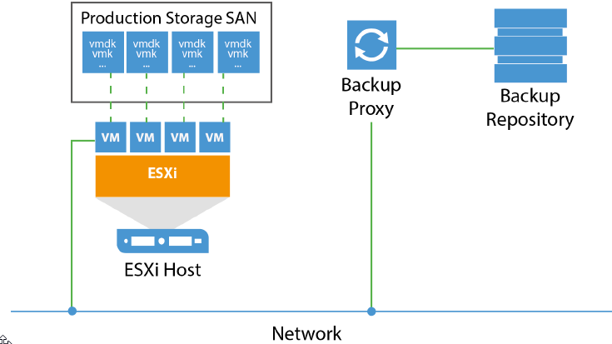
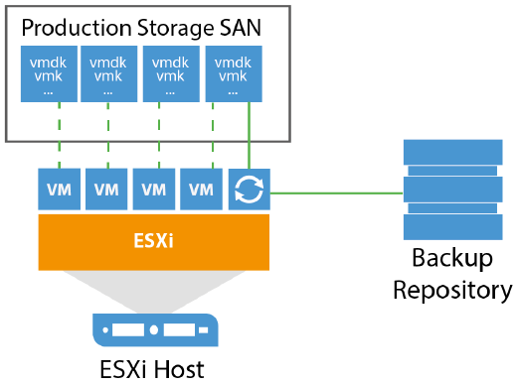
Alternative Systems

Slide 23
Fin…

